Slide 1
Source Code Control

Slide 2
Note
This presentation is intended to be a continuation of “The Essentials of File Management with LabVIEW”

Slide 3
Session Goals
This session focuses on best practices for:
Reviewing the Challenges of Source Code Control with LabVIEW
Organizing Your Application for Team Development
Notes:
In this session, I will teach you best practices for organizing your LabVIEW application. I’ll share tools to make your team development more efficient through effective source code control, as well as strategies for reusing code among teams or projects.
I think every developer can relate to the “unexpected complications” that often crop up during development, especially when dealing with a large project with multiple contributors. We’re not alone, and there are many common pitfalls that teams can fall into. Personally, many projects I’ve worked on have met set-backs, whether it was during code integration, testing, or even after deployment. Even small projects with a single developer face challenges in terms of code organization and management. It happens, so how can we avoid it?
My goal today is to share some strategies with you to help your software development projects run as smoothly as possible, saving you time by avoiding common pitfalls of the application developer.

Slide 4
Reviewing the Challenges of Source Code Control with LabVIEW

Slide 5
LabVIEW with Source Code Control
//How are LabVIEW VIs saved? – binary files
//How does this affect how it interacts with source code control tools?

Slide 6
Source Code Control with Text Based
//flowchart or graphic for this workflow

Slide 7
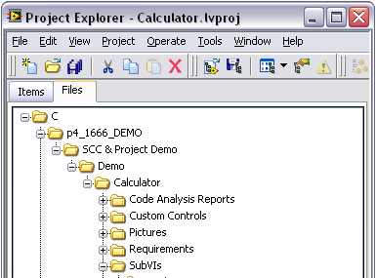
Benefits of the Project Explorer
//Benefit of the Files View
//Does not duplicate files

Slide 8
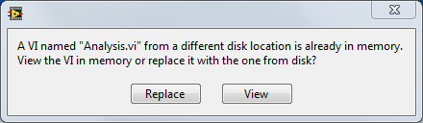
Load a VI From Disk
Load “analysis.vi” from disk
VI with the same name open in memory?
no
yes
Load “analysis.vi” from disk
click replace
click view
Use copy of “analysis.vi” in memory
Notes:
When we load a VI from disk, LabVIEW immediately checks to see if there is already a VI of that name open in memory. If there is, a conflict occurs because LabVIEW is unsure which version to load, and the user will be prompted to resolve the conflict. If there is not a VI of that name open in memory, then LabVIEW will load the version from disk.
[transition] How does the picture change when loading a subVI?

Slide 9
Load a SubVI
Calling VI attempts to load subVI
no
VI with the same name open in memory?
yes
Look for subVI at location on disk
Use copy in memory
find
missing
Use subVI at specified location
Search for subVI in**: 1. vi.lib
2. user.lib
3. instr.lib
4. \Labview2012\Resource
**default
configuration
Notes:
When loading a subVI, things get a little bit more complicated. When a caller VI tries to load a subVI, LabVIEW will first check to see whether a VI of the same name is already open in memory. If a copy is already open in memory, then LabVIEW will automatically use this version. This can lead to a behavior called cross-linking, where an unexpected copy of a VI is used.
If a copy of the subVI is not already in memory, then LabVIEW will try to find the subVI at the expected location on disk. If it is successful, then LabVIEW will load the subVI at the specified location on disk. If that version cannot be found, then LabVIEW will execute a search for a VI with the same name in vi.lib, user.lib, and instr.lib. The first VI with the correct name that is found is the one that is loaded.
[transition] These search paths can be configured, but it is important to understand how VIs are loaded to understand and avoid cross-linking.

Slide 10
Cross-Linking Defined
Calculator.vi
Simple Display.vi
Analysis.vi
Scientific Calculator.vi
Analysis.vi
Enlarged Display.vi
??? Analysis.vi not found at expected location
Notes:
Cross-linking occurs when a VI in memory references a different subVI than the one it was last saved with, one that the developer didn’t intend to reference.
In this example, two top-level VIs, calculator.vi and scientific calculator.vi, both call subVIs by the name analysis.vi. The two analysis.vi files may contain completely different source code from one another. Remember, items in memory are unique by name, but multiple VIs of the same name can exist on disk. If calculator.vi does not find its copy of analysis.vi on disk, it may load the wrong copy of the subVI with the same name.
[transition] Cross-linking can be difficult to track down and tricky to resolve. Often, the best solution is trying to prevent it all together.

Slide 11



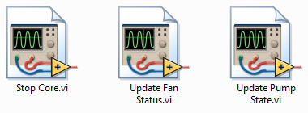
When Can Cross-Linking Occur?
If you back-up working directories by creating multiple copies, you will end up with many copies of a given VI on your machine.
Notes:
A common source of cross-linking occurs if you create back-ups of code on your machine by creating duplicate folders containing versions of the same set of VIs. This is commonly done, and I think at some point everyone in the room has been guilty of it. When I created this presentation, I had versions V1 to V6 scattered across my desktop. This can be a problematic practice in LabVIEW because it makes cross-linking possible.
Keep in mind that if you share a networked drive with colleagues, or perhaps as a location to back-up code, your caller VI might be cross-linked against a back-up VI that doesn’t even exist on your machine. Cross-linking can be very tricky so a best practice is to limit creating copies of VIs and VIs with generic names.
[transition] When cross-linking does occur, your project file can help notify you.

Slide 12
Organizing your Application for Team Development

Slide 13
Organizing Your Project Team
//Include questions you ask yourself and your team when starting a new project
Discussion: What other things should we consider?
Notes:
How many developers?
How many projects?
Is this application distributed to customers?

Slide 14
Organizing Your Project Explorer
//Include recommendations for starting the organization of your Project Explorer

Slide 15
What is _____?
//Discuss what the SCC tool is
//Include benefits and drawbacks to this tool
//Comment on the learning curve for this tool

Slide 16
Organizing Your Repository – General Recommendation
//Use this as a template and modify to your recommendation
Recommendation: Add a branch for any new features
Recommendation: Once the feature is complete, move the feature to the trunk
Branch
Trunk
Recommendation: Create a new trunk for each new project

Slide 17
General Workflow Recommendations
Weekly meetings
//Modify this to show your recommended workflow
Central Repository
Download changes from central server
Commit changes to the central server
Make changes to your code
Local Repository
Updated Local Repository
Notes:
http://git-scm.com/book/en/Distributed-Git-Distributed-Workflows

Slide 18
Team Development Project Use Case #1
//Include a team development scenario and include a completed “Organizing Your Workflow” and “Workflow Recommendations” slides

Slide 19
Team Development Project Use Case #2
//Include a team development scenario and include a completed “Organizing Your Workflow” and “Workflow Recommendations” slides

Slide 20
Team Development Project Use Case #3
//Include a team development scenario and include a completed “Organizing Your Workflow” and “Workflow Recommendations” slides
Discussion: What other use cases do you see arising?

Slide 21
Tags in Source Code Control
//Include comments on how you use tags with source code control and LabVIEW

Slide 22
Files to include and exclude in SCC
//NOTE: This may or may not be helpful since there are many opinions about this. Added as a placeholder, but not sure how useful it would be.

Slide 23
Summary
//Provide a summary of recommendations for using LabVIEW with SCC

Slide 24
Questions?

